Slide 1
Threads and Concurrency
Definition (wikipedia): a thread of execution is the smallest sequence of programmed instructions that can be managed independently by a scheduler, which is typically a part of the operating system. Multiple threads can exist within one process, executing concurrently and sharing resources such as memory.

Slide 2
Motivation
Most modern applications are multithreaded
Threads run within application
Multiple tasks with the application can be implemented by separate threads
Update display
Fetch data
Spell checking
Answer a network request
Process creation is heavy-weight while thread creation is light-weight
Can simplify code, increase efficiency
Kernels are generally multithreaded

Slide 3
Multithreaded Server Architecture

Slide 4
Benefits
Responsiveness – may allow continued execution if part of process is blocked, especially important for user interfaces
Resource Sharing – threads share resources of process, easier than shared memory or message passing
Economy – cheaper than process creation, thread switching lower overhead than context switching
Scalability – process can take advantage of multiprocessor architectures

Slide 5
Multicore Programming
Multicore or multiprocessor systems putting pressure on programmers, challenges include:
Dividing activities
Balance
Data splitting
Data dependency
Testing and debugging
Parallelism implies a system can perform more than one task simultaneously
Concurrency supports more than one task making progress
Single processor / core, scheduler providing concurrency

Slide 6
Concurrency vs. Parallelism
Concurrent execution on single-core system:
Parallelism on a multi-core system:

Slide 7
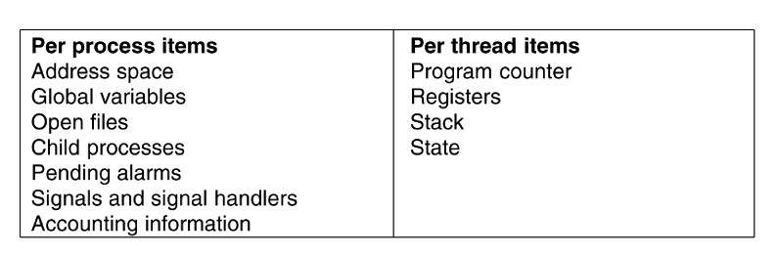
Threads (3)
Figure 2-7. The first column lists some items shared by all threads in a process. The second one lists some items private to each thread.
Tanenbaum & Woodhull, Operating Systems: Design and Implementation, (c) 2006 Prentice-Hall, Inc. All rights reserved. 0-13-142938-8
Notes:
7

Slide 8
Single and Multithreaded Processes

Slide 9
User Threads and Kernel Threads
User threads - management done by user-level threads library
Three primary thread libraries:
POSIX Pthreads
Windows threads
Java threads
Kernel threads - Supported by the Kernel
Examples – virtually all general purpose operating systems, including:
Windows
Solaris
Linux
Tru64 UNIX
Mac OS X

Slide 10
Multithreading Models
Many-to-One
One-to-One
Many-to-Many

Slide 11
Thread Libraries
Thread library provides programmer with API for creating and managing threads
Two primary ways of implementing
Library entirely in user space
Kernel-level library supported by the OS

Slide 12
Pthreads
May be provided either as user-level or kernel-level
A POSIX standard (IEEE 1003.1c) API for thread creation and synchronization
Specification, not implementation
API specifies behavior of the thread library, implementation is up to development of the library
Common in UNIX operating systems (Solaris, Linux, Mac OS X)

Slide 13
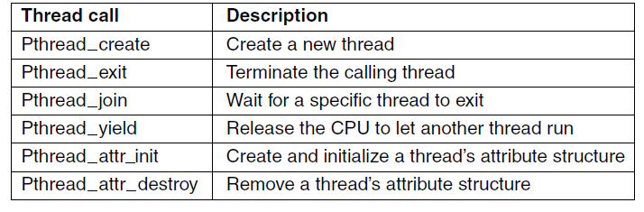
POSIX Threads (1)
Figure 2-14. Some of the Pthreads function calls.
Tanenbaum & Bo,Modern Operating Systems:4th ed., (c) 2013 Prentice-Hall, Inc. All rights reserved.

Slide 14
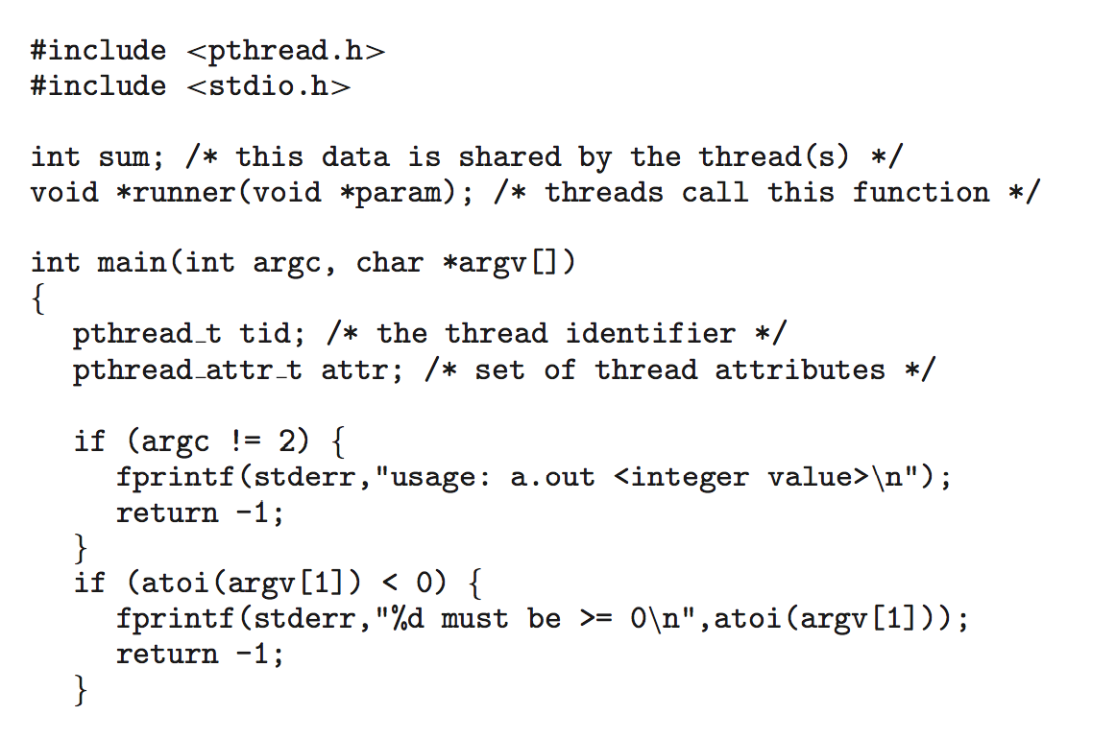
Pthreads Example

Slide 15
Pthreads Example (Cont.)

Slide 16
Pthreads Code for Joining 10 Threads

Slide 17
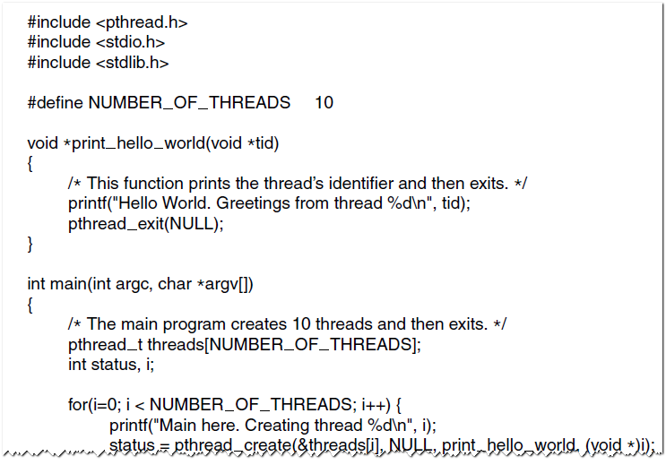
POSIX Threads (2)
Figure 2-15. An example program using threads.
Tanenbaum & Bo,Modern Operating Systems:4th ed., (c) 2013 Prentice-Hall, Inc. All rights reserved.

Slide 18
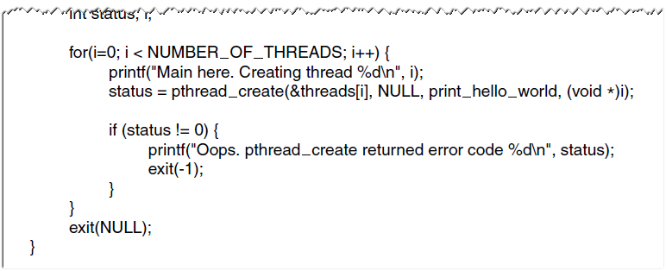
POSIX Threads (3)
Figure 2-15. An example program using threads.
Tanenbaum & Bo,Modern Operating Systems:4th ed., (c) 2013 Prentice-Hall, Inc. All rights reserved.

Slide 19
Race Conditions
Two processes want to access shared memory at the same time
Thread A
counter++;
Thread B
counter--;
counter
5
lw $r2, counter
addi $r2, $r2, 1
sw $r2, counter
lw $r3, counter
subi $r3, $r3, 1
sw $r3, counter
r2
6
4
r3
Tanenbaum & Woodhull, Operating Systems: Design and Implementation, (c) 2006 Prentice-Hall, Inc. All rights reserved. 0-13-142938-8
Notes:
19

Slide 20
Race Condition
counter++ could be implemented as register1 = counter register1 = register1 + 1 counter = register1
counter-- could be implemented as register2 = counter register2 = register2 - 1 counter = register2
Consider this execution interleaving with “count = 5” initially:
S0: producer execute register1 = counter {register1 = 5} S1: producer execute register1 = register1 + 1 {register1 = 6} S2: consumer execute register2 = counter {register2 = 5} S3: consumer execute register2 = register2 – 1 {register2 = 4} S4: producer execute counter = register1 {counter = 6 } S5: consumer execute counter = register2 {counter = 4}

Slide 21
Critical Section Problem
Consider system of n processes {p₀, p₁, … p_{n-1}}
Each process has critical section segment of code
Process may be changing common variables, updating table, writing file, etc
When one process in critical section, no other may be in its critical section
Critical section problem is to design protocol to solve this
Each process must ask permission to enter critical section in entry section, may follow critical section with exit section, then remainder section

Slide 22
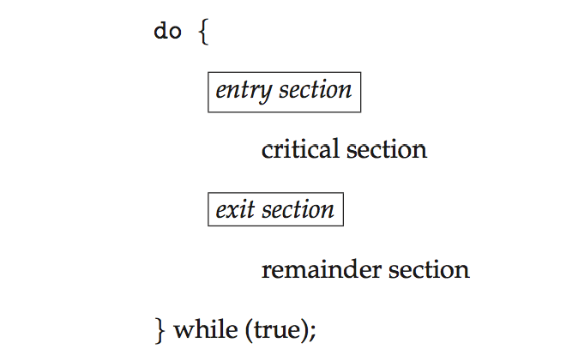
Critical Section
General structure of process P_{i}

Slide 23
Algorithm for Process P_{i}
do {
while (turn == j);
critical section
turn = j;
remainder section
} while (true);

Slide 24
Solution to Critical-Section Problem
1. Mutual Exclusion - If process P_{i} is executing in its critical section, then no other processes can be executing in their critical sections
2. Progress - If no process is executing in its critical section and there exist some processes that wish to enter their critical section, then the selection of the processes that will enter the critical section next cannot be postponed indefinitely
3. Bounded Waiting - A bound must exist on the number of times that other processes are allowed to enter their critical sections after a process has made a request to enter its critical section and before that request is granted
Assume that each process executes at a nonzero speed
No assumption concerning relative speed of the n processes

Slide 25
Critical Sections
Necessary to avoid race conditions:
1. No two processes may be simultaneously inside their critical regions.
2. No assumptions may be made about speeds or the number of CPUs.
3. No process running outside its critical region may block other processes.
4. No process should have to wait forever to enter its critical region.
Tanenbaum & Woodhull, Operating Systems: Design and Implementation, (c) 2006 Prentice-Hall, Inc. All rights reserved. 0-13-142938-8
Notes:
25

